Slide 1

Terrain classification using 3D optical tactile sensor
A machine learning approach
Jiader Chou

Slide 2
Overview
Background
Goals of the thesis
Implementation
Robot
Enviroment setup
Segmentation of sensor data
Feature sets
Evaluation
Results and further improvement
Conclusion
Future work

Slide 3
Background
Terrain classification
Sensors
Tactile is one of the most informative

Slide 4
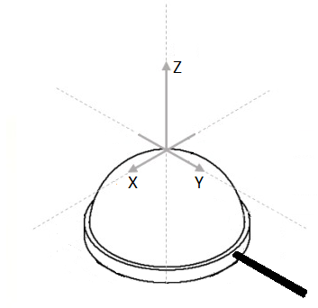
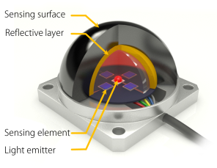
3D optical tactile sensor
High sensitivity, small size, light weight and low detection time

Slide 5
Goals of the thesis
Evaluate 3D optical force sensor for the terrain classification problem
Investigating and developing a reliable approach for data processing, preprocessing, feature selection, and classification for the presented sensor.

Slide 6
Implementation
Robot
Enviorment setup
Segmentation of sensor data
Feature sets
Evaluation of the sensor

Slide 7
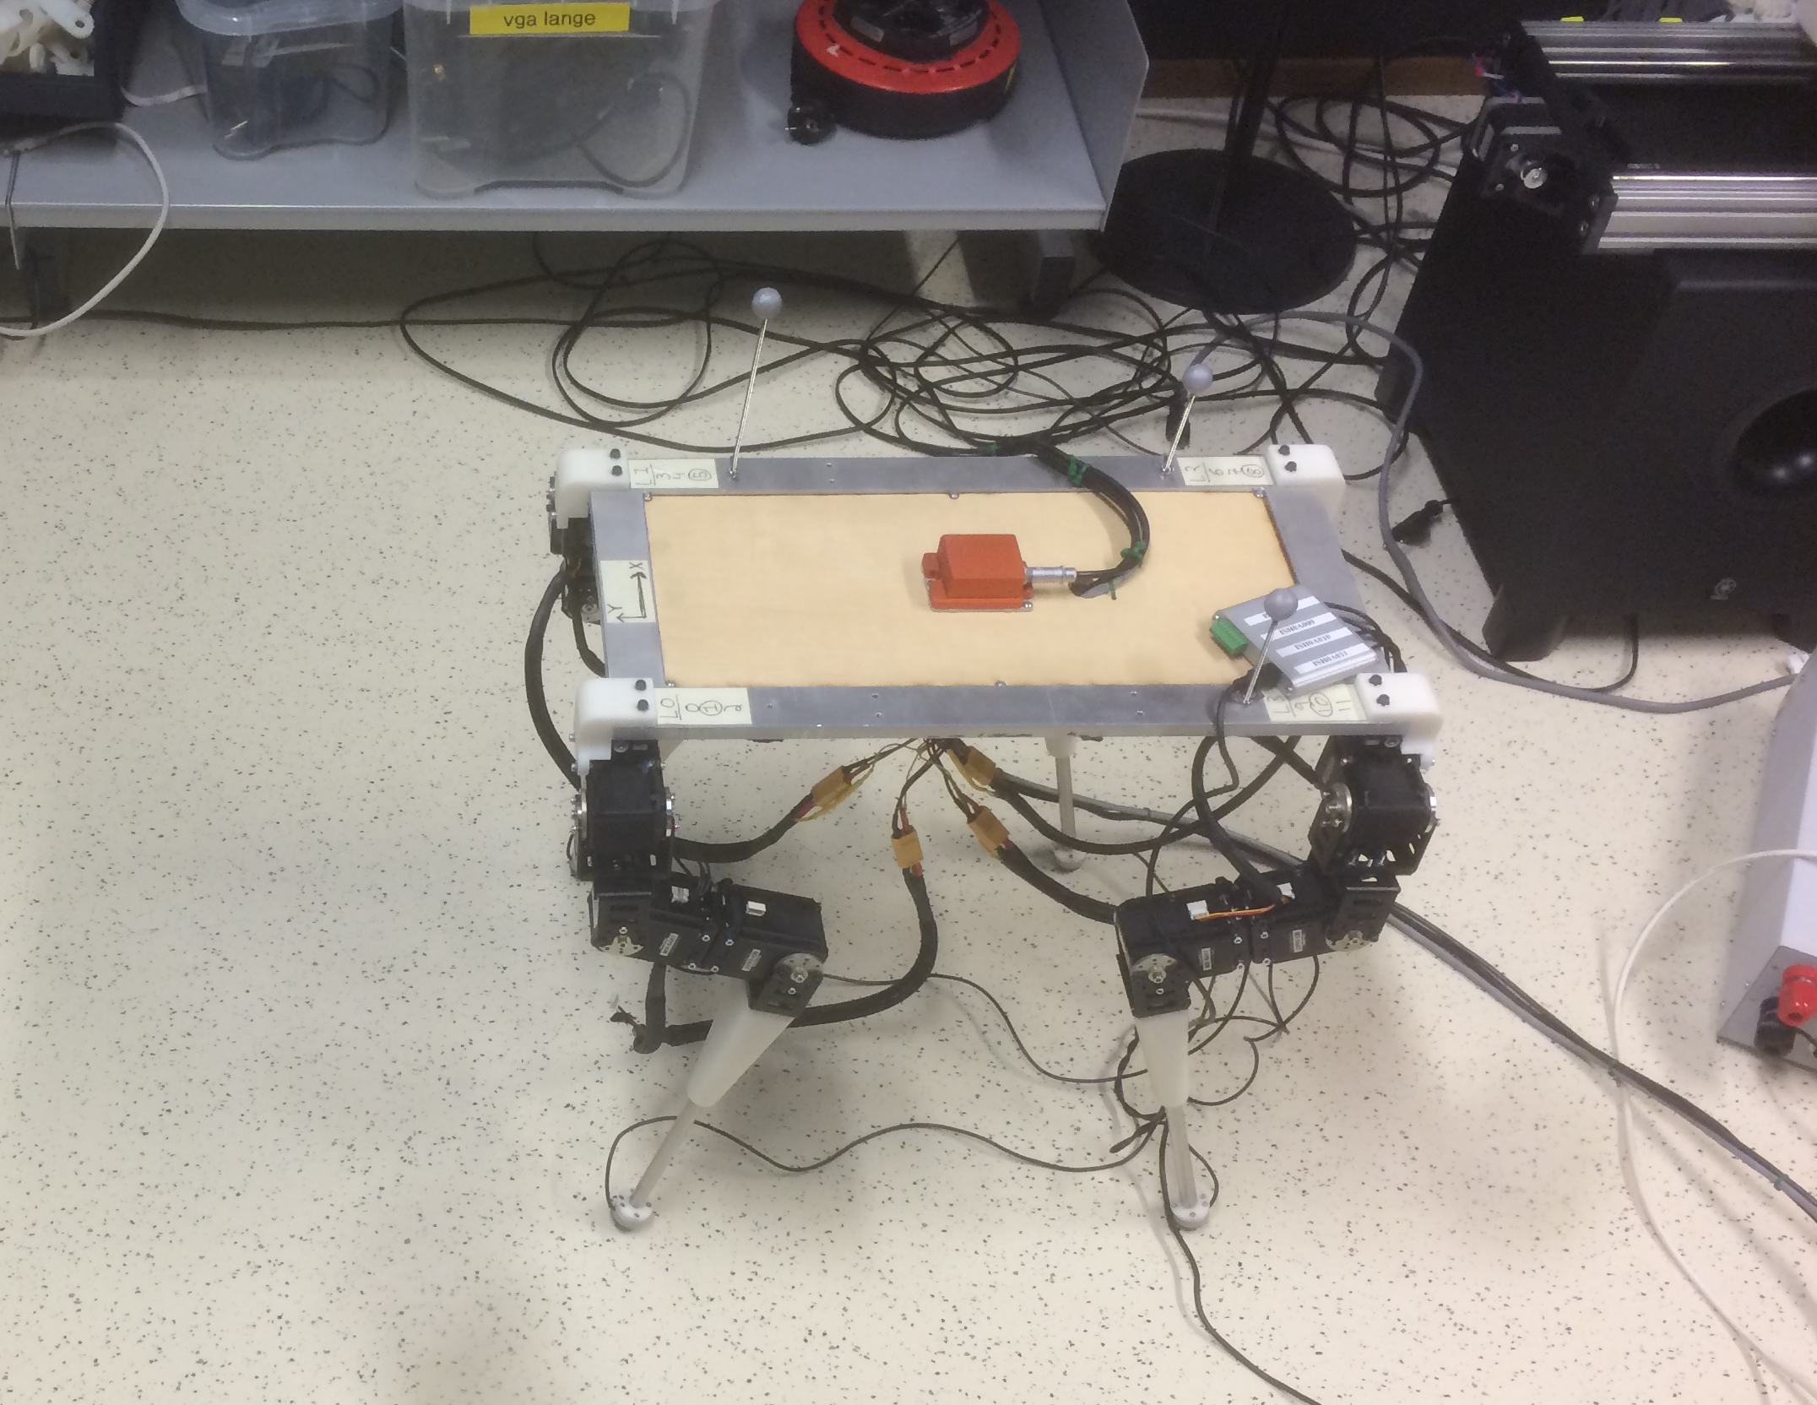
Robot

Slide 8
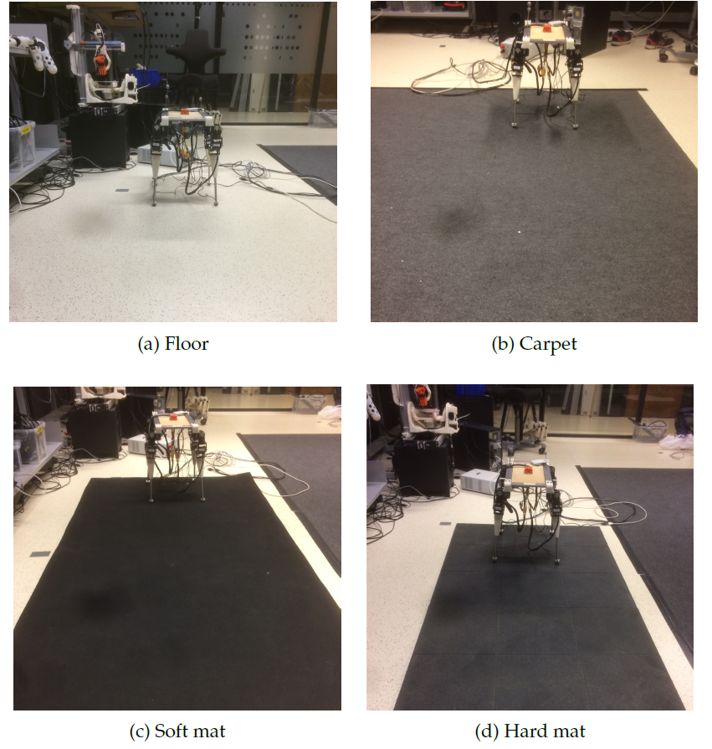
Enviroment setup

Slide 9
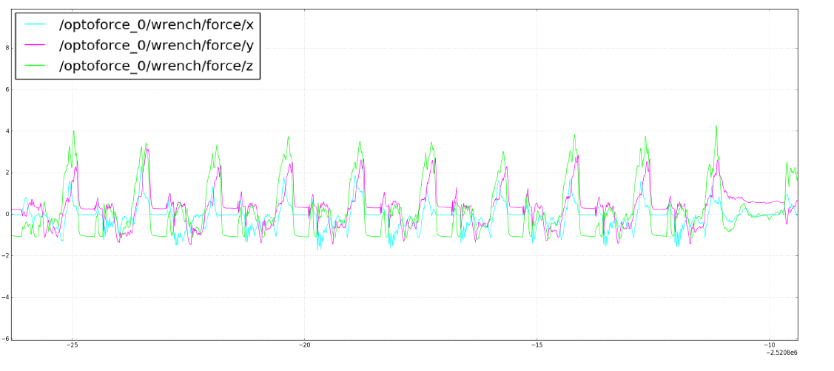
Segmentation of sensor data

Slide 10
Feature sets
Set one
Raw data
Set two
Statistical features in the time domain; max, min, mean, variance, skewness, kuortosis, standard deviation
Set three
Complete frequency domain
Set four
Statistical features in the frequency domain; max, min, mean, variance, skewness, kuortosis, standard deviation, energy
Set five
Set two and four

Slide 11
Classifiers
Neural network
Naive Bayes
SVM
Decision tree
KNN

Slide 12
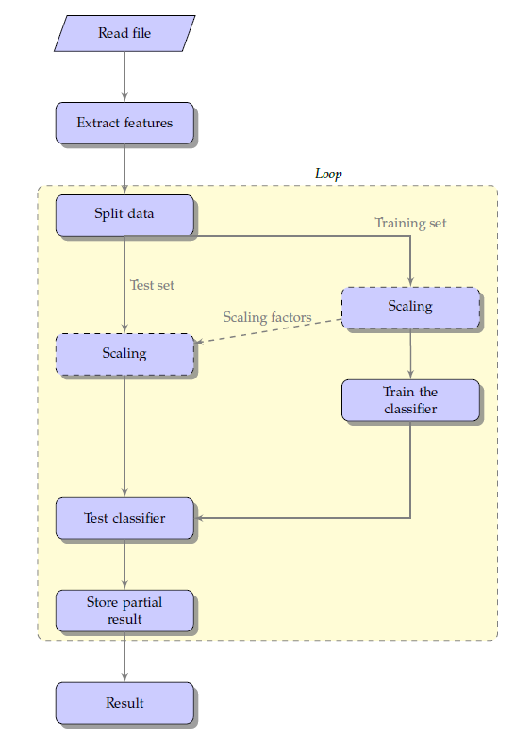
Create and test machine learning model

Slide 13
Evaluation
Find the best approach
Test the implementation
Integrate feature selection
Test on new data set
Hyperparameter tuning
Investigate the real-time implementation
Using the best approach to test the transistion between two terrains
Investigate the other sensor
Using training data from front left foot of the robot to predict sensor data from right front foot

Slide 14
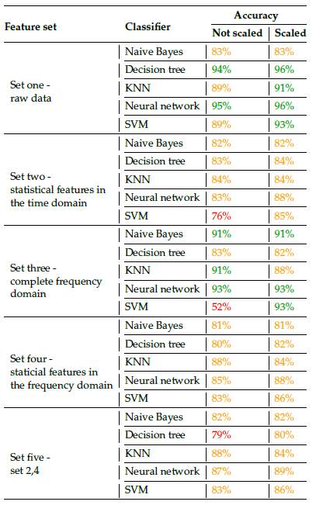
Results

Slide 15
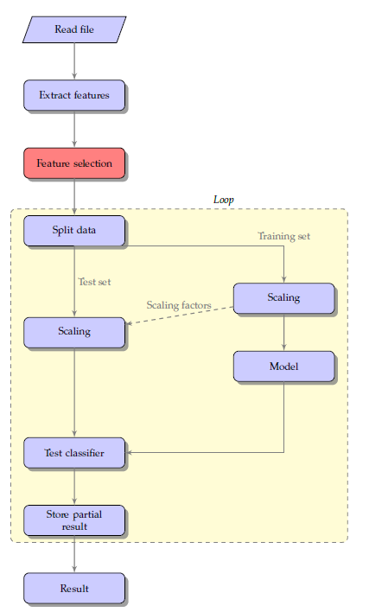
Integrating feature selection

Slide 16
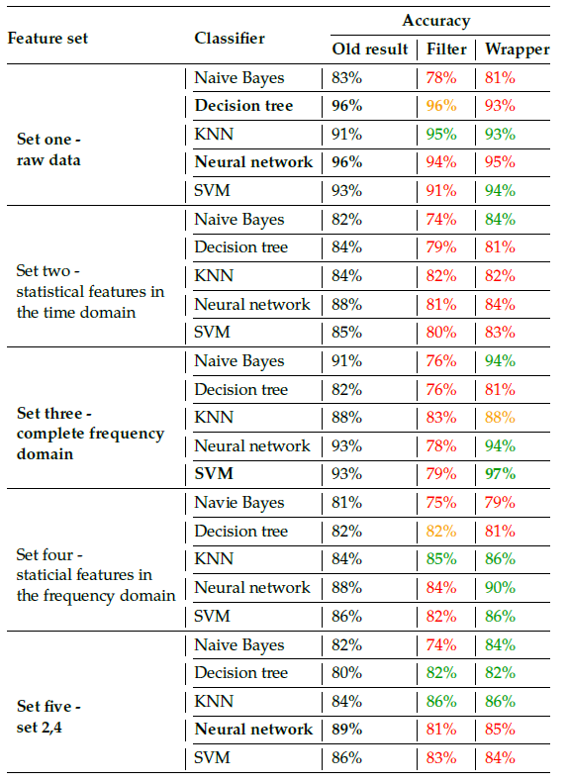
Results

Slide 17
Test on new data set
Feature set | Classifier | Feature selection | Current result
Set three | SVM | RFE (wrapper) | 97%
Set one | Neural network | None | 96%
Set one | Decision tree | RFLV (filter) | 96%
Set one | Decision tree | None | 96%
Set five | Neural network | None | 89%

Slide 18
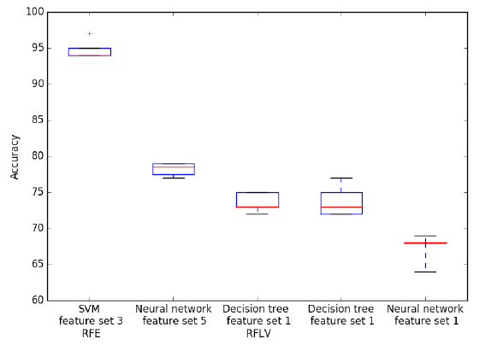
Results

Slide 19
Hyperparameter tuning
Feature set | Classifier | Feature selection
Set three | SVM | RFE
Set five | Neural network | None

Slide 20
Hyperparameter tuning
SVM
Kernel
C
Neural network
Hidden layer
Binary representation of output

Slide 21
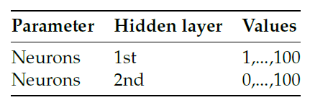
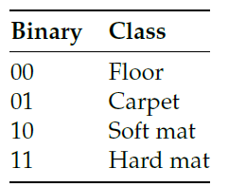
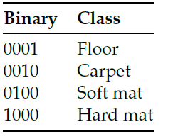
Tuning neural network
Binary representation of terrains

Slide 22
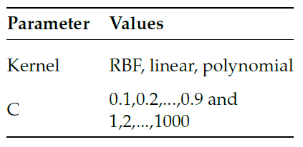
Tuning SVM

Slide 23
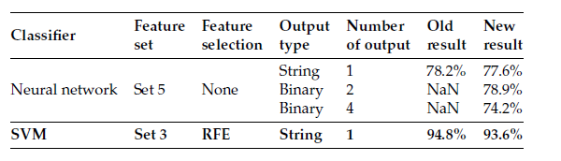
Results

Slide 24
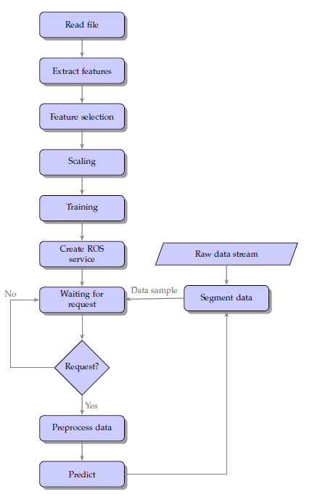
Real-time implementation

Slide 25
Classification in real-time
Floor to carpet
Hard mat to floor
Hard mat to soft mat
Soft mat to hard mat
Soft mat to carpet

Slide 26
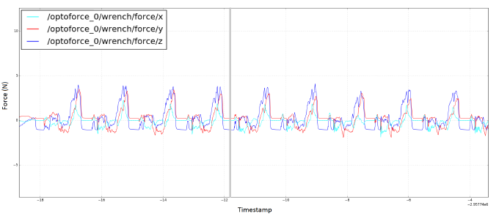
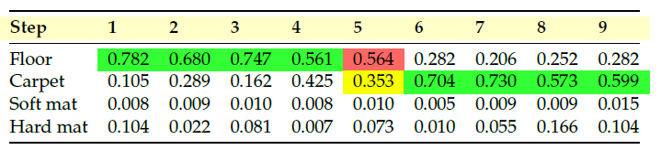
Floor to carpet

Slide 27
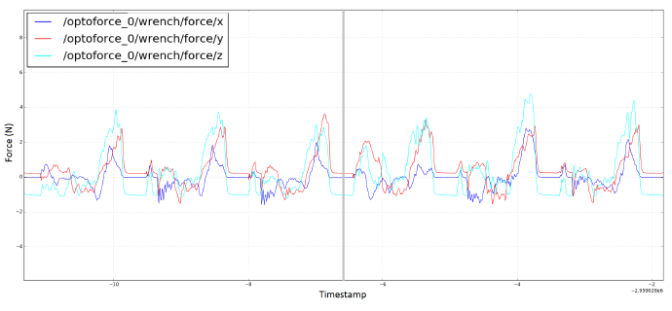
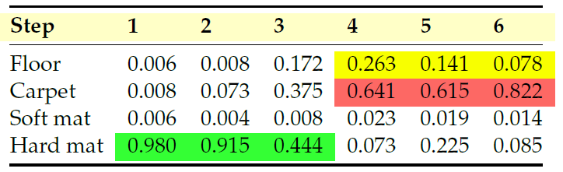
Hard mat to floor

Slide 28
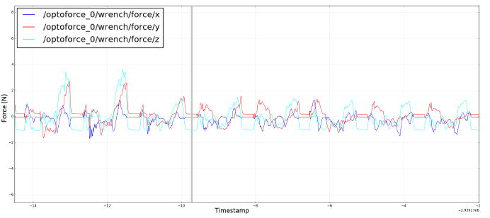
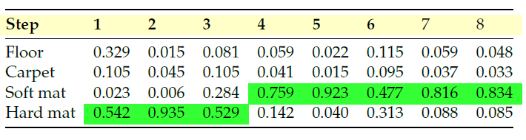
Hard mat to soft mat

Slide 29
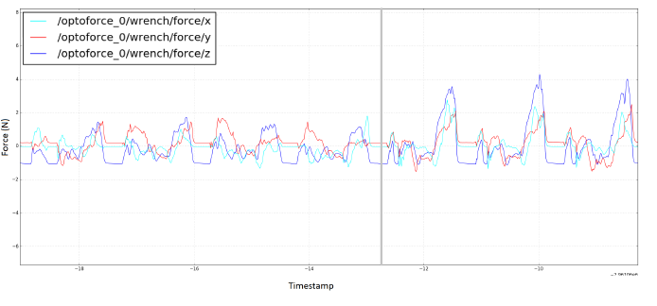
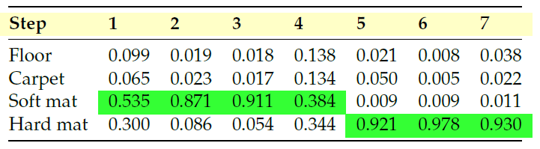
Soft mat to hard mat

Slide 30
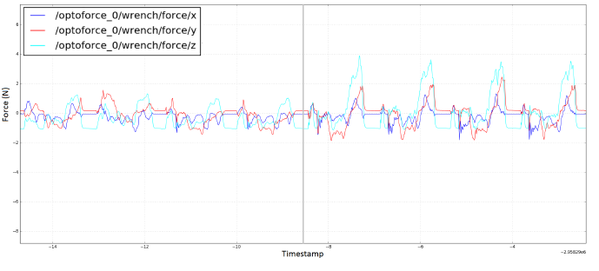
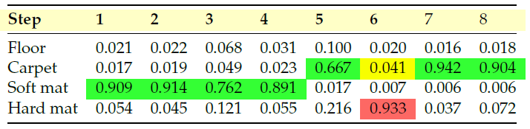
Soft mat to carpet

Slide 31
Investigate the other sensor
Using training data from front left foot of the robot to predict sensor data from right front foot

Slide 32
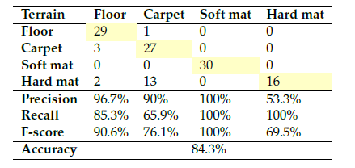
Results

Slide 33
Conclusion
The results confirm that the 3D optical force sensor is suitable to use for terrain classification
The best combination is using feature selection on the complete frequency domain with SVM

Slide 34
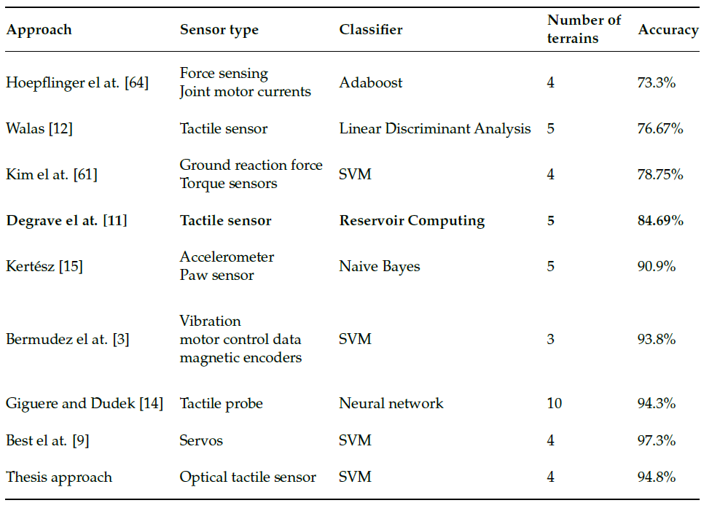
Compared to earlier work

Slide 35
Future work
Features of the terrain itself such as hardness and friction are not analyzed directly
Include rougher surfaces
Incorporating all four sensor
Utilized with other sensors
Unsupervised learning
Gait changing on different terrains

